Slide 1
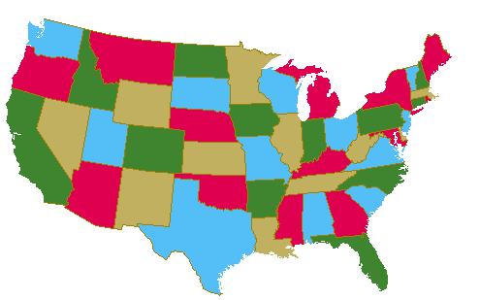
Graph Colouring
Lecture 20: Nov 25

Slide 2
This Lecture
Graph coloring is another important problem in graph theory.
It also has many applications, including the famous 4-color problem.
Graph coloring
Applications
Planar graphs

Slide 3
Graph Colouring
Graph Colouring Problem:
Given a graph, colour all the vertices so that
two adjacent vertices get different colours.
Objective: use minimum number of colours.
3-colourable

Slide 4
Optimal Colouring
Definition. min #colors for G is chromatic number, (G)
What graphs have chromatic number one?
when there are no edges…
What graphs have chromatic number 2?
What graphs have chromatic number larger than 2?
A path? A cycle? A triangle?

Slide 5
Simple Cycles

Slide 6
Complete Graphs

Slide 7
Wheels

Slide 8
Trees
root
Pick any vertex as “root.”
if (unique) path from root is
even length:
odd length:
Can prove more formally using induction.

Slide 9
2-Colourable Graphs
When exactly is a graph 2-colourable?
This is 2-colourable.
2 colourable: tree, even cycle, etc.
Not 2 colourable: triangle, odd cycle, etc.

Slide 10
Bipartite Graphs
When exactly is a graph 2-colourable?
Is a bipartite graph 2-colourable?
Is a 2-colourable graph bipartite?
Fact. A graph is 2-colourable if and only if it is bipartite.

Slide 11
Bipartite Graphs
When exactly is a graph bipartite?
Can a bipartite graph has an odd cycle?
NO
If a graph does not have an odd cycle, then it is bipartite?

Slide 12
Bipartite Graphs
When exactly is a graph bipartite?
No such edge because no 5-cycle
The idea is like colouring a tree.
Pick a vertex v, colour it red.
Colour all its neighbour green.
Colour all neighbours of green vertices red
Repeat until all vertices are coloured.
No such edge because no triangle
If a graph does not have an odd cycle, then it is bipartite?
Theorem. A graph is bipartite if and only if it has no odd cycle.

Slide 13
Chromatic Number
How do we estimate the chromatic number of a graph?
If there is a complete subgraph of size k,
then we need at least k colours?
YES
Is the converse true?
If a graph has no complete subgraph of size 4,
then we can colour it using 4 colours?
NO
What graphs are 3-colourable?
No one knows a good characterization…

Slide 14
This Lecture
Graph coloring
Applications
Planar graphs

Slide 15
Flight Gates
flights need gates, but times overlap.
how many gates needed?
time
122
145
67
257
306
99
Flights

Slide 16
Conflict Graph
Needs gate at same time
145
Each vertex represents a flight
Each edge represents a conflict
306
99

Slide 17
Graph Colouring
257
122
145
67
306
9
There is a k-colouring in this graph iff the flights can be scheduled using k gates.
=> If there is a schedule, the flights scheduled at the same gate have no conflict,
and so we can colour the graph by using one colour for flights in each gate.
<= If there is a graph colouring, then the vertices using each colour have no conflict,
and so we can schedule the flights having the same colour in one gate.

Slide 18
Colouring the Vertices
257
122
145
assign
gates:
67
306
257, 67
122,145
99
306
4 colors
4 gates
99

Slide 19
Better Colouring
257
122
145
67
306
3 colors
3 gates
99

Slide 20
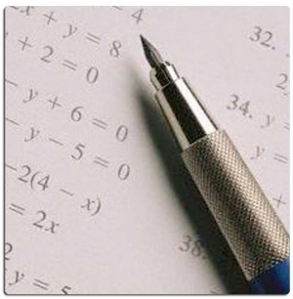
Final Exams
subjects conflict if student takes both,
so need different time slots.
how short an exam period?
This is a graph colouring problem.
Each vertex is a course, two courses have an edge if there is a conflict.
The graph has a k-colouring if and only if
the exams can be scheduled in k days.

Slide 21
Graph Colouring
8.02
6.042
18.02
assign
times:
3.091
M 9am
M 1pm
T 9am
T 1pm
4 time slots
(best possible)
6.001

Slide 22
Register Allocation
Given a program, we want to execute it as quick as possible.
Calculations can be done most quickly if the values are stored in registers.
But registers are very expensive, and there are only a few in a computer.
Therefore we need to use the registers efficiently.
This is a graph colouring problem.

Slide 23
Register Allocation
Each vertex is a variable.
Two variables have a conflict if they cannot be put into the same register.
a and b cannot use the same register, because they store different values.
c and d cannot use the same register otherwise the value of c is overwritten.
Each colour corresponds to a register.

Slide 24
Good News
For some special graphs, we know exactly when they are k-colourable.
Interval graphs (conflict graphs of intervals):
b
b
d
d
a
a
c
c
For interval graphs,
minimum number of colours need = maximum size of a complete subgraph
So the “flight gate” problem and the “register allocation” can be solved.

Slide 25
This Lecture
Graph coloring
Applications
Planar graphs

Slide 26
Map Colouring
Colour the map using minimum number of colours so that
two countries sharing a border are assigned different colours.

Slide 27
Map Colouring
Can we draw a map so that there are 5 countries
such that any two of which are adjacent?
NO
Can we draw a map which need 5 colours?
NO
Conjecture (1852) Every map is 4-colourable.
“Proof” by Kempe 1879, an error is found 11 years later.
(Kempe 1879) Every map is 5-colourable.
Theorem (Apple Haken 1977). Every map is 4-colourable.
The proof is computer assisted, some mathematics are still not happy.

Slide 28
Planar Graphs
- Each vertex is a region.
- Two regions have an edge
if they are adjacent.
This is a planar graph.
A graph is planar if there is a way to
draw it in the plane without edges crossing.

Slide 29
Non-Planar Graphs
Can we draw a map so that there are 5 countries
such that any two of which are adjacent?
NO

Slide 30
Four Continuous Faces
An important concept of a planar graph is its faces.
So let’s study it in some details.
II
IV
II
I
4 Connected Regions

Slide 31
Region Boundaries
b
a
c
d

Slide 32
Region Boundaries
abca
b
a
c
d

Slide 33
Region Boundaries
abca
b
abda
a
c
d

Slide 34
Region Boundaries
abca
b
abda
a
c
acda
d
outer region

Slide 35
Region Boundaries
abca
b
abda
a
bcdb
c
acda
outer region
d

Slide 36
Region Boundaries: Bridge

Slide 37
Region Boundaries: Bridge
f
b
a
c
e
efge
abcda
g
d
abcefgecda
outer region

Slide 38
Region Boundaries: Dongle

Slide 39
Region Boundaries: Dongle
s
r
y
x
v
t
w
rstur
outer region
u

Slide 40
Region Boundaries: Dongle
s
r
y
x
v
t
w
u

Slide 41
Region Boundaries: Dongle
s
stvxyxvwvturs
r
y
x
v
t
w
rstur
u

Slide 42
Planar Embeddings
A planar embedding is a graph along with its face boundaries: cycles
(same graph may have different embeddings)
two length 5 faces
length 7 face

Slide 43
Euler’s Formula
If a connected planar graph has v vertices, e edges, and f faces, then
v –e +f = 2
v=5, e=5, f=2
v=6, e=10, f=6
v=9, e=8, f=1

Slide 44
Proof of Euler’s Formula
If a connected planar graph has v vertices, e edges, and f faces, then
v –e +f = 2
Proof by induction on the number of vertices.
Base case (v=1):
v=1
f=e+1

Slide 45
Proof of Euler’s Formula
If a connected planar graph has v vertices, e edges, and f faces, then
v –e +f = 2
Induction step (v>1):
“contract” the red edge
v’=v-1, e’=e-1, f’=f
Number of faces is the same, although some faces get shorter.
By induction, v’-e’+f’=2. This implies v-e+f=2.

Slide 46

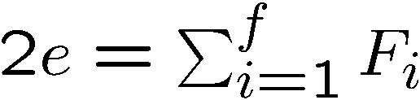
Application of Euler’s Formula
Claim. If G is a simple planar graph with at least 3 vertices, then
e <= 3v-6
Let be the face lengths.
Note that
Contributes one to two faces
because each edge contributes 2 to the sum
Contributes two to one face

Slide 47
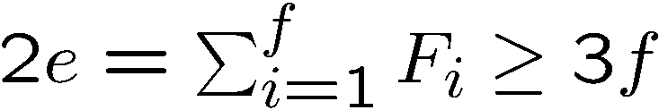
Application of Euler’s Formula
Claim. If G is a simple planar graph with at least 3 vertices, then
e <= 3v-6
Let be the face lengths.
Note that
Since the graph is simple, each face is of length at least 3.
So
Since e = v+f-2, this implies

Slide 48
Application of Euler’s Formula
Claim. If G is a simple planar graph with at least 3 vertices, then
e <= 3v-6
Claim. Every simple planar graph has a vertex of degree at most 5.
Suppose every vertex has degree at least 6.
Then e >= 6v/2 = 3v.
A contradiction.

Slide 49
6-Colouring Planar Graphs
Claim. Every simple planar graph has a vertex of degree at most 5.
Theorem. Every planar graph is 6-colourable.
v
Proof by induction on the number of vertices.
Let v be a vertex of degree at most 5.
Remove v from the planar graph G.
Note that G-v is still a planar graph.
By induction, G-v is 6-colourable.
Since v has at most 5 neighbours,
v can always choose a colour (from the 6 colours).
G-v

Slide 50
Application of Euler’s Formula
Can we draw a map so that there are 5 countries
such that any two of which are adjacent?
NO
Can this graph have a planar drawing?
Claim. If G is a simple planar graph with at least 3 vertices, then
e <= 3v-6
This graph has v=5 and e=10, and so does not satisfy the claim.

Slide 51
Polyhedra
Icosahedron gives a 5 regular planar graph.

